Slide 1
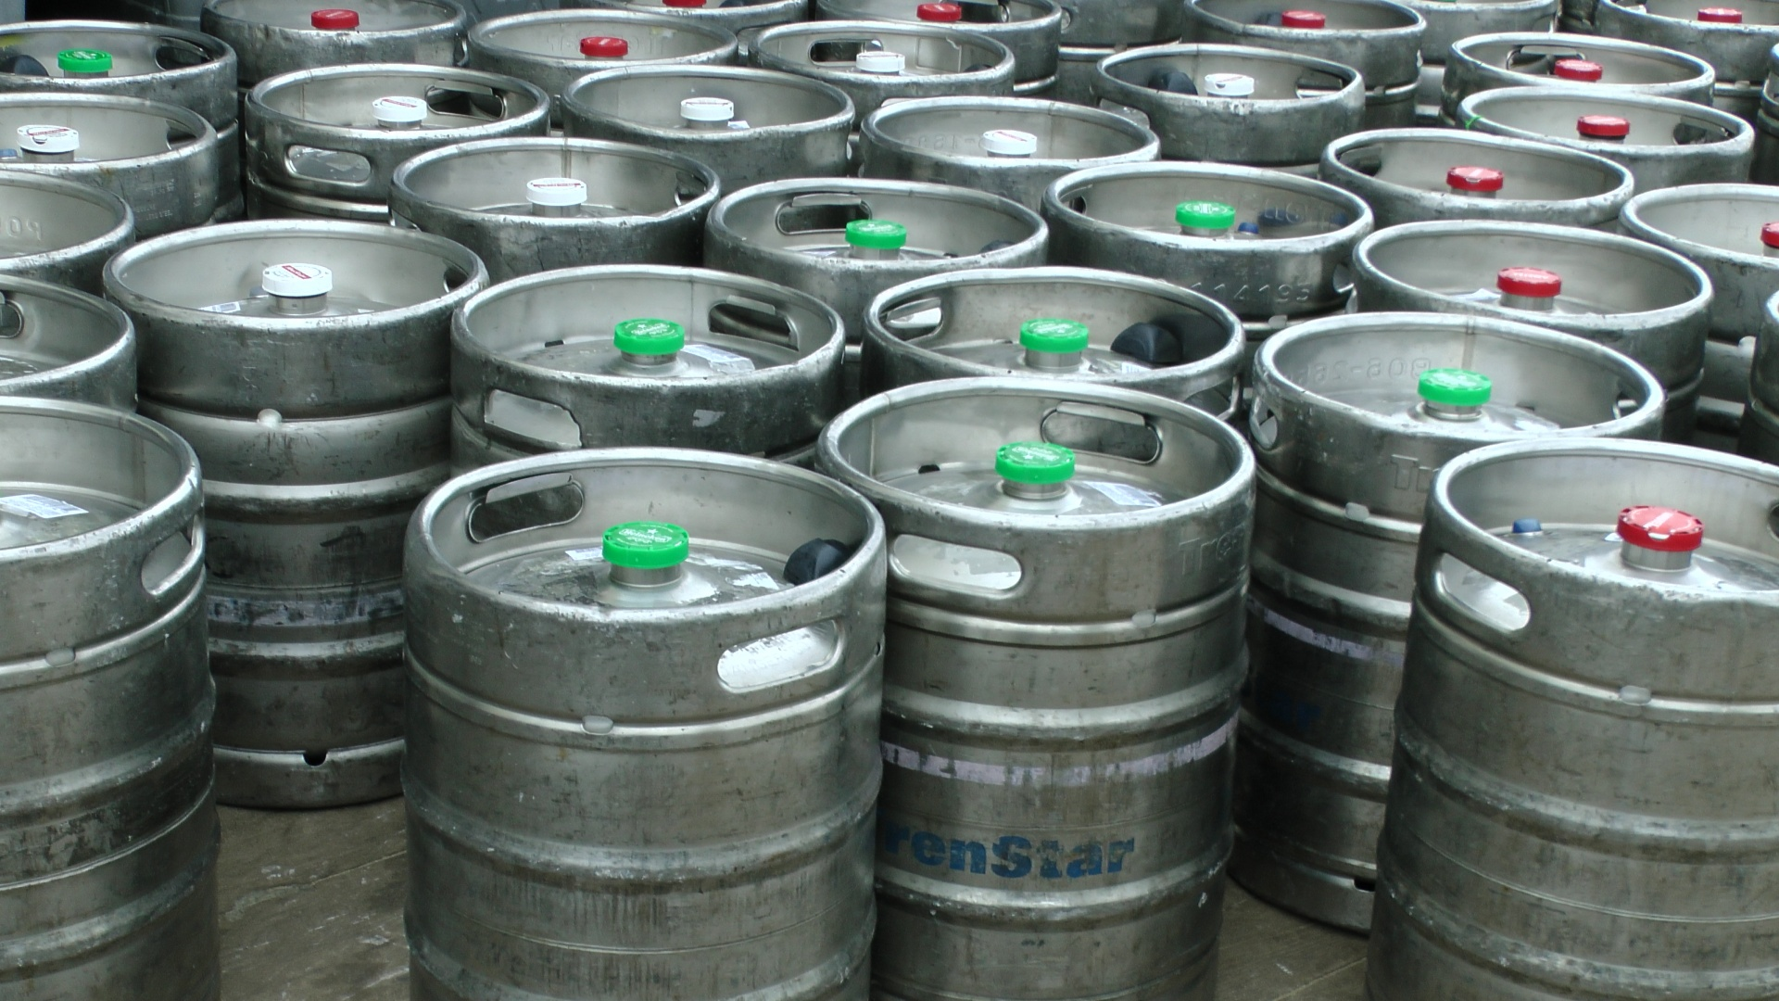
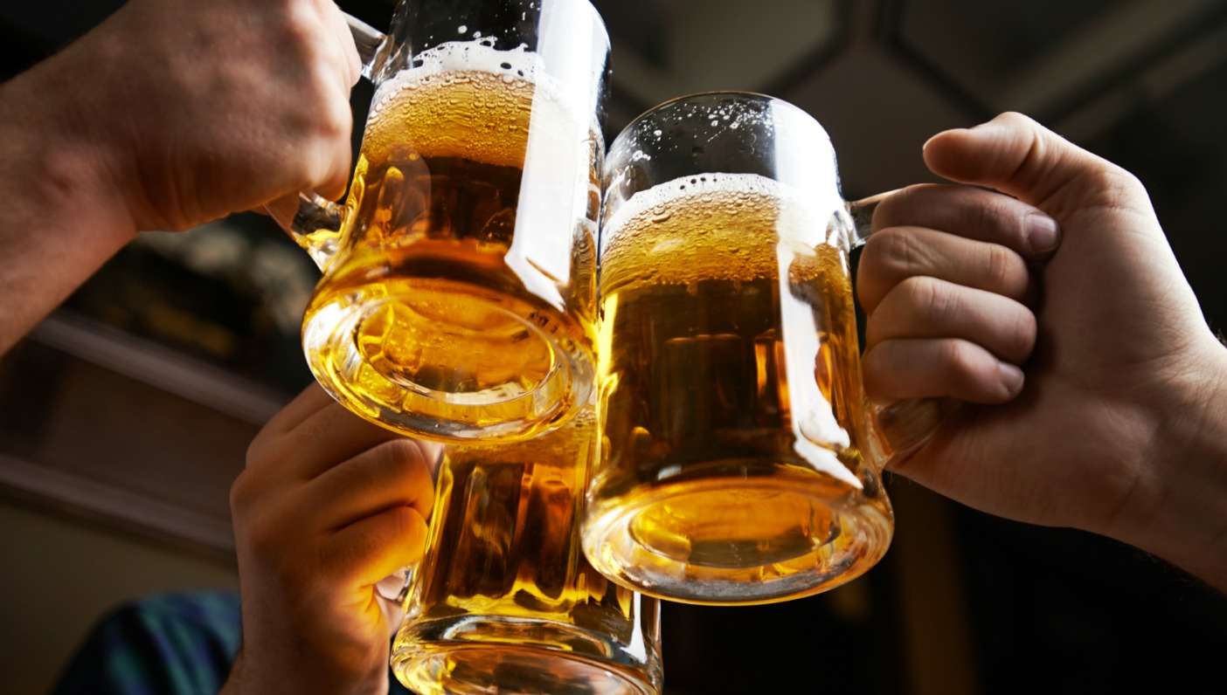
ALLDET
AUTOMATED LIQUID
LEVEL DETECTION
Jesse Tutor, Zach Fauver, Khara Robinson, Andrew Bullington, Ryan Ladd

Slide 2
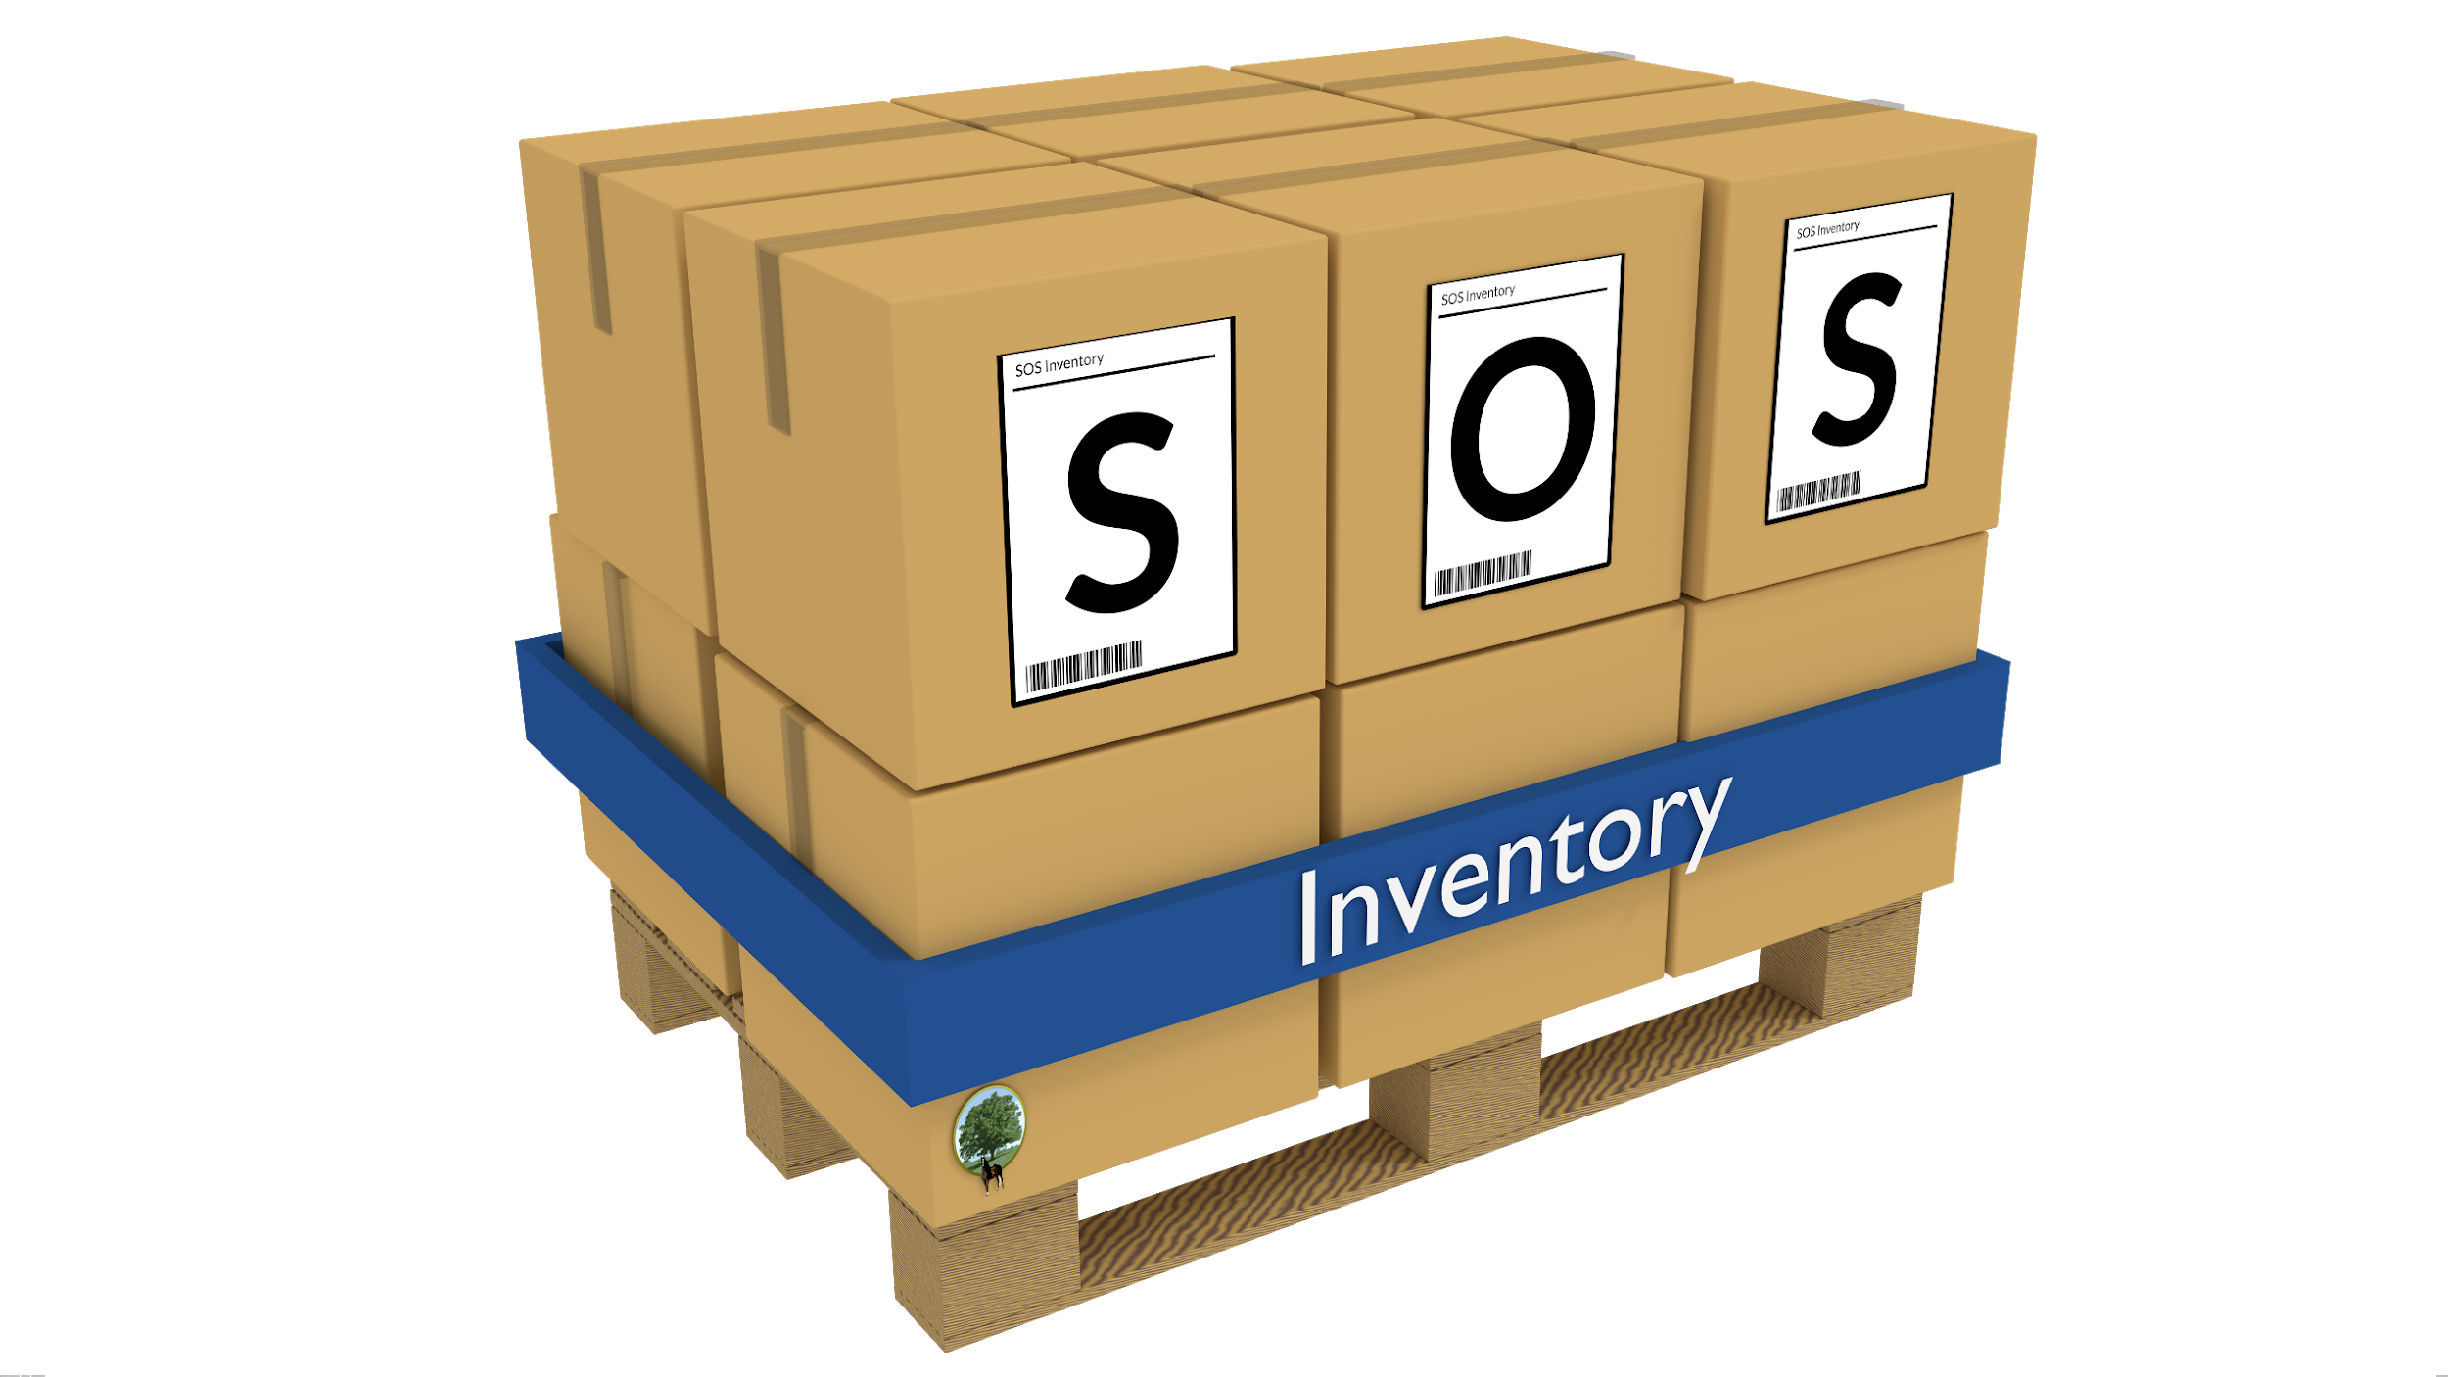

WHAT PROBLEM ARE WE SOLVING?
Difficulty tracking amount of beer in a keg
Over-pouring or giving away free drinks
Long, tedious bar inventory process

Slide 3

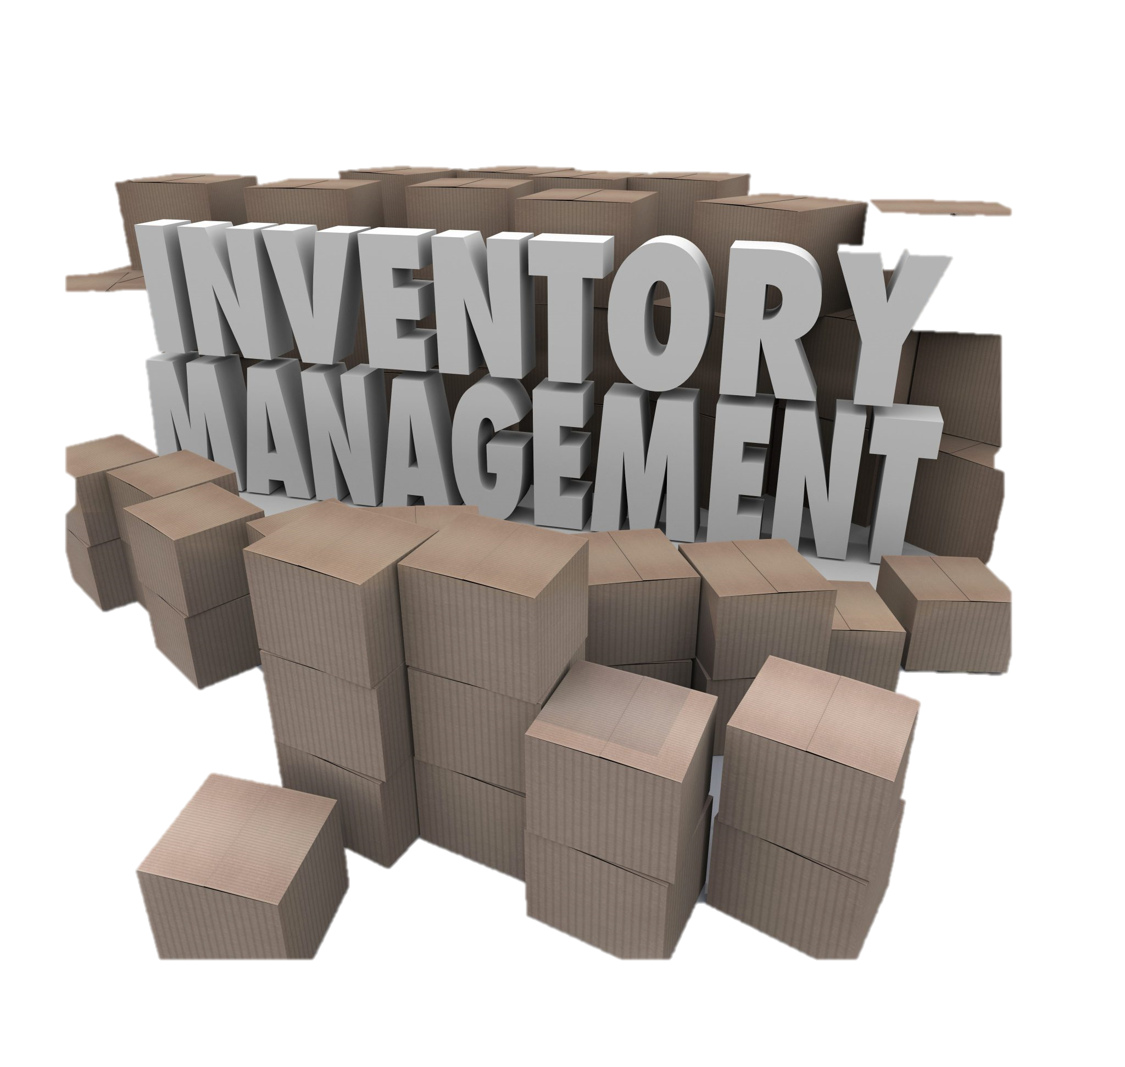
OUR SOLUTION
Simple, user-friendly keg level detection
Attach device to the side of the keg to determine the content level
No more heavy lifting to weigh kegs
Eliminate time wasted on inventory tracking

Slide 4

TARGET CUSTOMERS
Business-to-business
Main customers:
Restaurants
Bars
Breweries
Future development would allow pursuing other industries (i.e. oil drums, flammable chemicals, etc.)

Slide 5




SALES & MARKETING STRATEGY
Customer trials to gain feedback
Word of mouth
Live demos
Social media advertising
Cold calls

Slide 6
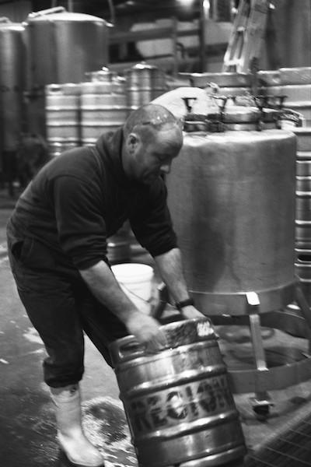
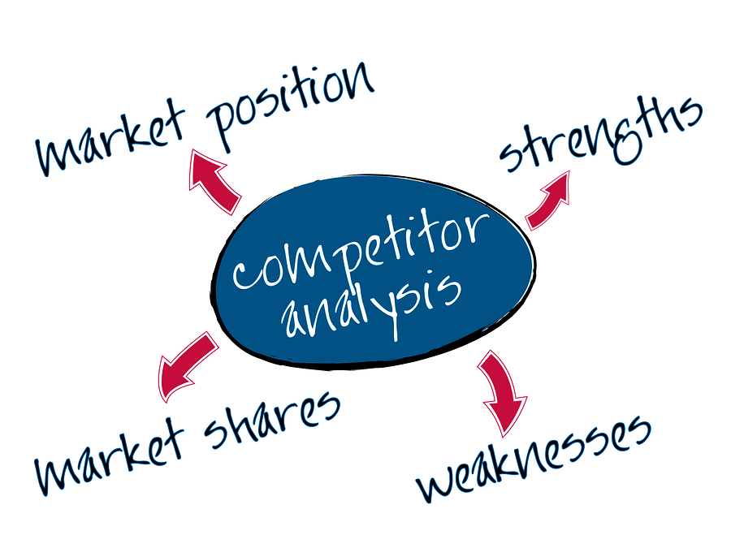
COMPETITIVE ADVANTAGE
No new or modified containers
No manual labor
Automated data entry and analytics
Remote measurements

